Slide 1
CS2040 Lab 1
Java Introduction

Slide 2

TA Introduction
Lim Daekoon
Year 3 CS Student
Specializations:
Algorithms
Parallel Computing
TA for CS2030S

Slide 3

TA Introduction
Liu Yangming
Year 2, School of Computing
Specializations:
Artificial Intelligence
Research

Slide 4
CS2040 Labs
2-hour session every Friday
Intended to provide hands-on experience with programming
Writing basic algorithms/data structures in Java
:(
One day assignments × 10
Take home assignments × 4

Slide 5
CS2040 Labs
One-day assignments
Solve one problem (1.5%) every week
Released on 8am every Friday
Finish by 8am next day
Ideally completed and “doable” within the lab itself

Slide 6
CS2040 Labs
Take-home assignments
2 problems per assignment (2 × 1.5%)
Total of 4 assignments
2 weeks to complete
Generally more challenging

Slide 7
Lab Structure
1st part of labs (max. 30 min): short lesson
Cover answers for the previous session’s assignments
(one-day, and take-home, where applicable)
Cover relevant Java API for the session’s given topic
Brief discussion of the one-day assignment

Slide 8
Lab Structure
2nd part of labs: solving the one-day assignment (graded)
First 20-30 minutes:
Plan how to solve the assignment
Express it in terms of pseudocode
Show pseudocode to to the TAs
Allowed to discuss at algorithm level with other students
But no discussing/sharing of code
Can continue working on the assignment after the lab if necessary

Slide 9
Lab Policy
You are NOT allowed to:
Copy another person’s code
Look at another person’s code
Use another person’s code as a base for your own code
Plagiarism checks will be in place

Slide 10
Grading Criteria
Marks received = [(# of test cases pass)/(# of test cases)]
Kattis stops grading your code on the first wrong test case.Your code will be re-run on all test cases before it is graded.

Slide 11
Discord Channel
Join link: http://bit.ly/cs2040lab09
Main platform for discussion
Ask about Lab/Tutorial stuff

Slide 12
Kattis Introduction
Online platform used for submitting and grading assignments
Found at https://nus.kattis.com/
Make sure you are at the correct site!

Slide 13
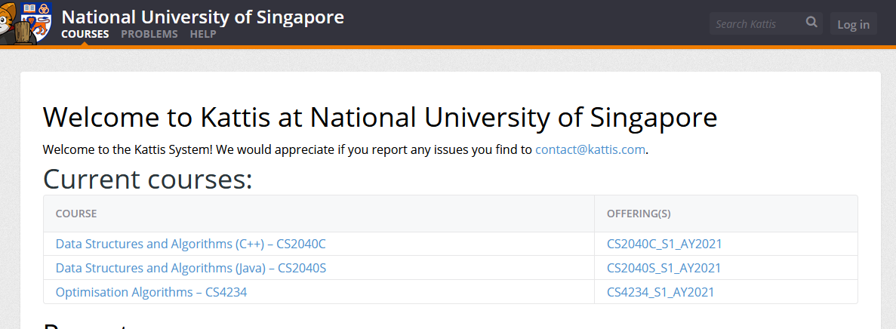
Kattis Introduction – Signing Up

Slide 14
Kattis Introduction – Signing Up

Slide 15
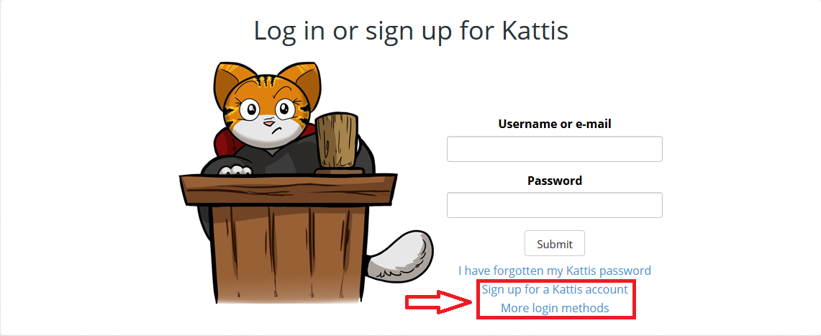
Kattis Introduction – Signing Up

Slide 16
Kattis Introduction – Signing Up
Can sign up using email, or through linking to Facebook/Google/LinkedIn
For name, please use your name as on LumiNUS, but only capitalize the first letter
e.g.. if your name on LumiNUS is “CHEN JIN XIONG, RYAN”
(not a real student, as far as I can tell)
then use “Chen Jin Xiong, Ryan” (ie, do not change the ordering)
Currently no way to edit an account name after creation, so be careful

Slide 17
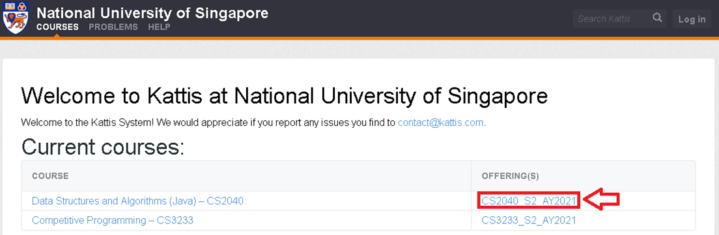
Kattis Introduction – Registering for CS2040S

Slide 18
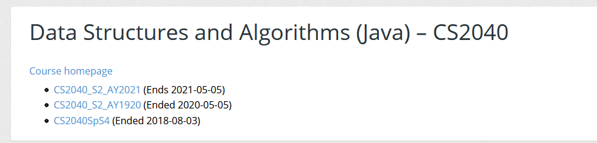
Kattis Introduction – Registering for CS2040S

Slide 19
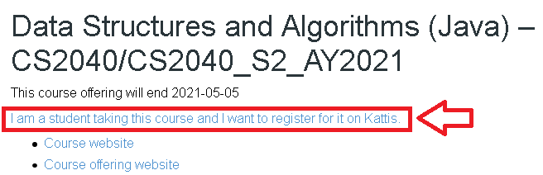
Kattis Introduction – Registering for CS2040S
Registration Code = cs2040_2021_s2_ckf

Slide 20
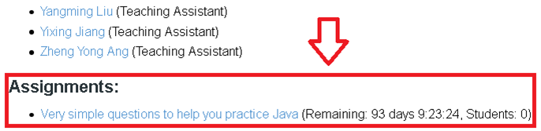
Kattis Introduction – Assignments
All problem sets will appear here (bottom of the page)

Slide 21
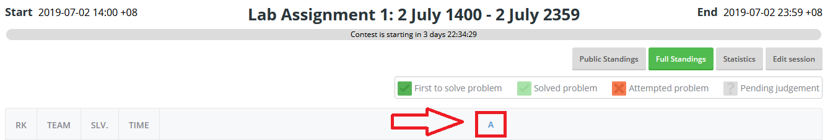
Kattis Introduction – Assignments
Click on the letter to access the problem
(only visible when session opens)

Slide 22
Correctness, Speed & Memory Usage
A correct algorithm/program may not be sufficient
May need to run fast as well, and use reasonable amount of memory
Captured in the idea of time complexity
Kattis provides the time limit for any problem
Description on the right, under “CPU Time limit”
Similarly, “Memory limit” is for space complexity

Slide 23
Runtime Analysis
Kattis servers can run ~100 million operations/second
2 second time limit => ~ 2×10⁸ ops
Will your program can pass within the time/memory limit?
Can guess based off its time/space complexity
Simplistic guess, not counting constant factors

Slide 24
Runtime Analysis
Problem with N <= 1000, 1 sec time limit:
O(N³) = 1 billion ops = probably not okay (> 100 million)
O(N²) = 1 million ops = probably okay
(Constant factor may make it/break it)

Slide 25
Correctness, Speed, Memory Usage
Some methods in Java API may not run in O(1) time
Your algorithm may run slower than intended if this is not taken into consideration
String x = ..., y = ...;
// String concat takes
// O(length(x) + length(y)) time
String z = x + y;
To fully understand the methods provided by the API
Recommended to read up the documentation

Slide 26
JavaDocs
Frequently used packages in 2040 are:
java.util
Collections (data structures)
Almost everything that’s covered later in the module
java.lang (Imported by default)
Strings and related classes (String, StringBuilder)
Boxed primitive classes (Integer, Double, Float,...)
java.io
Buffered input/output (covered in a later lab)

Slide 27
JavaDocs
Main window contains:
Brief description of class
Fields, constructors and methods with summarised description
Click on an entry for a formal description
Fields, constructors and methods with formal description
Time complexity of a method may be stated in the brief description of the class, or in the formal description of the methods

Slide 28
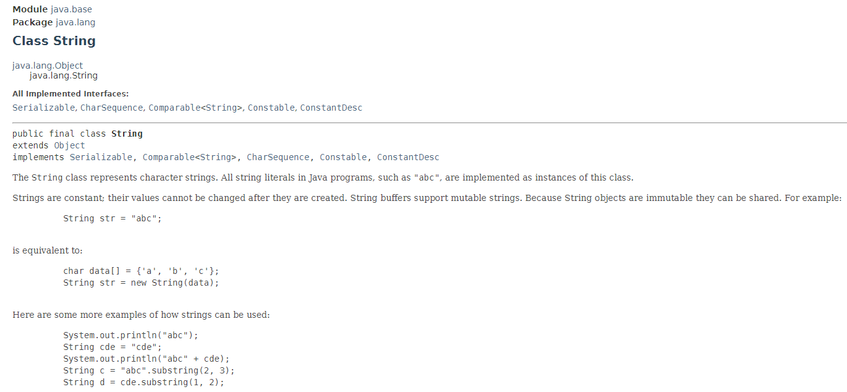
JavaDocs
Brief Description of Class
Example of important info
Sometimes, this will mention the time complexities of the different methods in this class.

Slide 29
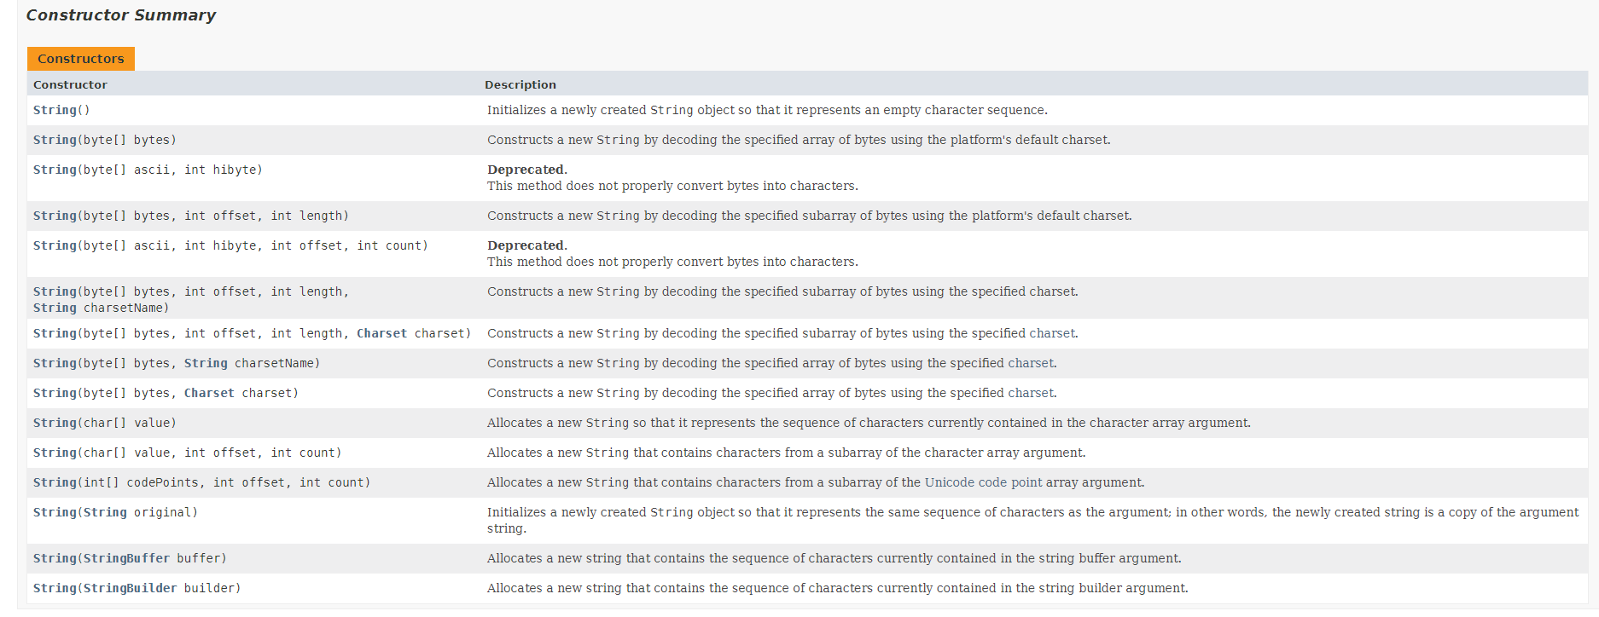
JavaDocs
Constructors with summarised description

Slide 30
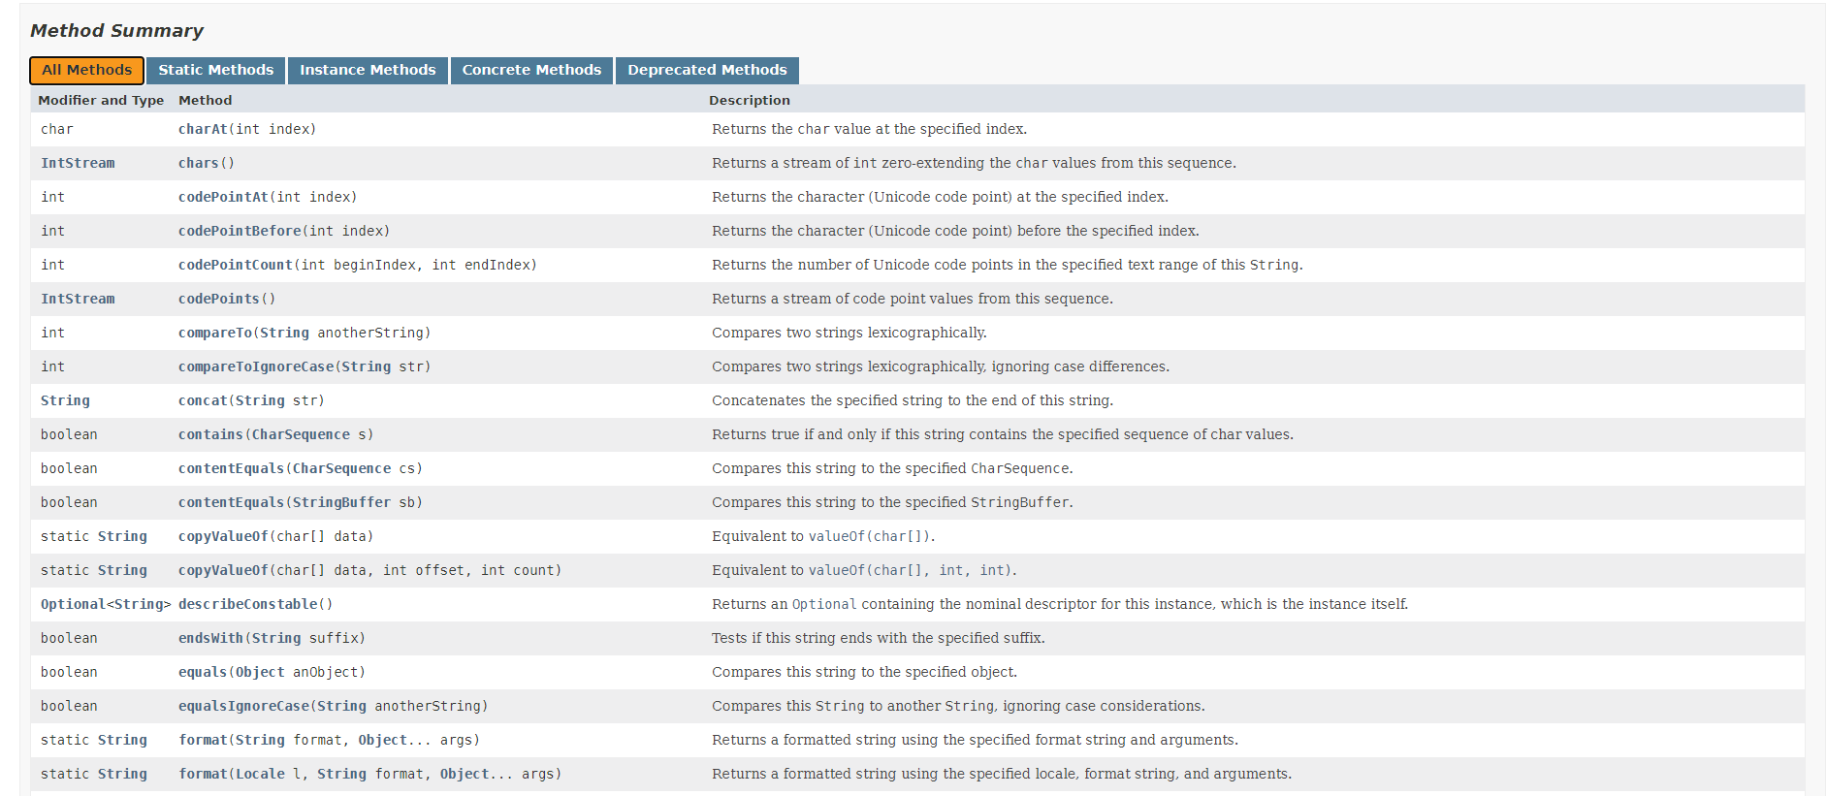
JavaDocs
Methods with summarised description

Slide 31
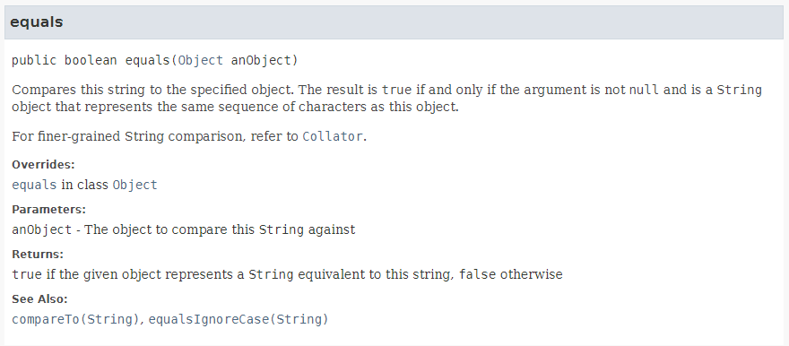
JavaDocs
Methods with formal description
Sometimes, this will mention the time complexities of this method.

Slide 32
Useful APIs: Scanner
Scanner class – used for reading input
Found in the java.util package
Import with import java.util.*;
Declare a new Scanner object:
Scanner sc = new Scanner(System.in); Constructs a Scanner wrapping standard input.
DO NOT construct multiple Scanners!
Read in input using the methods found in Scanner:
int testCases = sc.nextInt();
double length = sc.nextDouble();
String singleWord = sc.next();
String wholeLine = sc.nextLine();

Slide 33
Scanner API
“token” roughly means “word”
(surrounded by whitespace)
Method Signature | Description | Runtime
int nextInt() | Scans the next token of the input as an int. (Reads the next word of the input as an int.) | O(N)
double nextDouble() | Scans the next token of the input as a double. (Reads the next word of the input as an double.) | O(N)
String next() | Finds and returns the next complete token from this scanner. (Reads the next word of the input as a String.) | O(N)
String nextLine() | Advances this scanner past the current line and returns the input that was skipped. (Reads until it reaches the end of the current line.) | O(N)
N refers to the length of the input that is read.
Slides covering API will cover the most frequently used (but not all) methods of a class.

Slide 34
Scanner: Common Mistakes
Scanner has 2 “ways to read”
Token/word-based: nextInt(), nextDouble(), next(), etc. Reads word up to next whitespace character.
Line-based: nextLine() Reads all the way up to next newline.
Word-based & line-based don’t mix well

Slide 35
Scanner: Mixing Token- & Line-based Methods
Let’s say we are given the input:
123 abc

Slide 36
Scanner: Mixing Token- & Line-based Methods
We construct a Scanner around standard input.
Initially, the cursor is right before '1'.
123 abc

Slide 37
Scanner: Mixing Token- & Line-based Methods
Calling nextInt() reads a word "123"
Results in 123, an int
Now, the cursor is at the end of the first line.
123 abc

Slide 38
Scanner: Mixing Token- & Line-based Methods
Calling nextLine() now would give me the remainder of the line
i.e. the empty string
Not the next line "abc"
Now, the cursor is at the start of the second line:
123 abc
123 abc
In general, after calling a word-based next*() method, before we start reading lines: You can clean up the remainder of the line with a nextLine() call, which you ignore the result of.

Slide 39
Useful APIs: PrintStream (i.e. System.out)
PrintStream class – used for writing output
Found in the java.io package
Use the existing System.out Already a PrintStream wrapping standard output.
No need to create a separate one for now
Write output using the methods:
System.out.println(100); // Prints "100", and then a new line
System.out.print("asd"); // Prints "asd" and STAYS on the same line
System.out.println(); // Prints just a new line
System.out.printf("5 + 5 = %d\n", 5+5); // Prints "5 + 5 = 10", followed by a new line

Slide 40
PrintStream (i.e. System.out)
Method Signature | Description | Runtime
System.out.print(String str) | Prints a String. | O(N)
System.out.println(String str) | Prints a String and then terminate the line. (Prints a String, followed by a newline character ‘\n’) | O(N)
System.out.printf(String str) | (Emulates the printf function in C programming language.) | O(N)
N refers to the length of the output.
System.out is an instance of the PrintStream class.
You can refer to the API documentation on PrintStream to explore more methods.

Slide 41
String API
Represents a “string” of characters
Found in the java.lang package, imported by default
Immutable
Once created, value will never change
All “modifying” methods (e.g. .substring(), .trim()) construct copies.
Provides methods to manipulate Strings
Split up, take middle portion (substrings), trim whitespace, etc.

Slide 42
String API
Method Signature | Description | Runtime
String[] split(String regex) | Splits this string around matches of the given regular expression. | O(string-len)
char charAt(int i) | Returns the character value at the specified index (0-indexed). | O(1)
String concat(String str) | Concatenates the specified string to the end of this string. (Does not modify the original string, as they are immutable in Java.) | O(result-len)
int length() | Returns the length of this string. | O(1)
String substring (int beginIndex, int endIndex) | Returns a string that is a substring of this string. The substring begins at the specified beginIndex and extends to the character at index endIndex - 1. | O(result-len)

Slide 43
String API - Substrings
"abc".subString(2) -> "c".
subString(n) drops the first n characters/starts from the 0-indexed n-th character
"abcdef".subString(2,4) -> "cd"
Starts at index 2, ends BEFORE index 4
0
1
2
3
4
5
6
a | b | c | d | e | f
subString(2,4)

Slide 44
String API - Substrings
Make sure the string is long enough first
"abc".subString(4) will throw an error
4 is past the end
"abcdef".subString(7,9) will throw an error
7,9 also past the end
Alternatively, first perform a test such as
s.length() >= <expected-length>
s.startsWith(<some prefix>)

Slide 45
String API: Equality and Comparison
Method Signature | Description | Runtime
boolean equals(Object anObject) | Compares this string to the specified object. (Normally used with a String parameter, to check if the values are the same. This is not the same as using == ) | O(shorter-len)
int compareTo(String other) | Compares this string to the other String, in lexicographical (dictionary) ordering. this < other : Returns negative value this = other : Returns 0 this > other : Returns positive value | O(shorter-len)

Slide 46
String Equality: Common Mistakes
String/Object equality in Java
a == b tests reference equality
If a and b point to the same object in memory
"" == ("abc".substring(0,0)) (may) return false!
Even if both are “empty string” values
a.equals(b) tests value equality
If a and b have equal values
Or Objects.equals(a, b) if a is possibly null

Slide 47
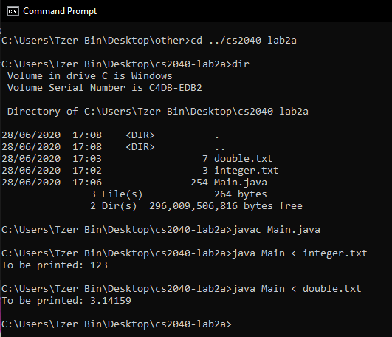
Command Line / Terminal Usage
Useful to know how to compile and execute Java programs, from the CLI
Images taken from CS2040 19/20 ST2
Credits to Tzerbin

Slide 48
Command Line / Terminal Usage
cd
Change Directory
..
Parent Directory

Slide 49
Command Line / Terminal Usage
dir
Print working directory

Slide 50
Command Line / Terminal Usage
javac
Compile Java files
Full file name with filename extention (.java) is needed
No output means compiled successfully
Each class is compiled into its own .class file.

Slide 51
Command Line / Terminal Usage
java
Execute Java programs
No filename extension (.java, .class)should be provided
<
Input direction
For providing input from a file
Allows you to save your input in a file to avoid retyping input each time you test your program

Slide 52
One-Day Assignment 0 – Pea Soup
First one-day assignment
Ungraded :)
Found at https://nus.kattis.com/problems/peasoup
Future assignments will be found on the main Kattis course page at https://nus.kattis.com/courses/CS2040S/CS2040S_S1_AY2021.
Writing pseudocode for this assignment is not necessary, but will be required from the next one-day assignment onwards

Slide 53
One-Day Assignment 0 – Pea Soup
Given a list of restaurants, and their menus:
Determine & print the first restaurant appearing in the list that:
Offers both “pea soup” and “pancakes” on their menu
Should be the exact strings "pea soup" and "pancakes"
Even if a menu item contains the substring “pea soup” or “pancakes”, ignore it
(see Sample Input 2)

Slide 54
Assignment Guidelines
Include your name and student number
In comments at the top of your code
You are allowed (and encouraged) to discuss algorithms
If so, list down all your collaborators in your source code comments
You are NOT allowed to: (see Lecture 0 slide 18)
Copy another person’s code
Look at/Reference another person’s code
Use another person’s code as a base for your own code
Plagiarism checks will be in place

